Slide 1
Equality and Relational Operators
Equality Operators:
Operator
==
!=
Example x == y x != y
Meaning
x is equal to y
x is not equal to y
Relational Operators:
Operator | Example | Meaning
> | x > y | x is greater than y
< | x < y | x is less than y
>= | x >= y | x is greater than or equal to y
<= | x <= y | x is less than or equal to y

Slide 2
Logical Operators
Logical operators are useful when we want to test multiple conditions
Three types:
boolean AND
boolean OR
boolean NOT

Slide 3
Boolean AND or logical AND
Symbol: &&
All the conditions must be true for the whole expression to be true
– Example:
if ( (a == 10) && (b == 10) && (d == 10) )
{
cout<<“a, b, and d are all equel to 10”;
}

Slide 4
Boolean OR / Logical OR
Symbol: ||
ANY condition is sufficient to be true for the whole expression to be true
– Example:
if (a == 10 || b == 9 || d == 1)
{
// do something
}

Slide 5
Boolean NOT/ Logical NOT
Symbol: !
Reverses the meaning of the condition (makes a true condition false, OR a false condition true)
– Example:
if ( ! (marks > 90) )
{
// do something
}

Slide 6
Bitwise Operators (integers)
Bitwise "and" operator &
Bitwise "or" operator |
Bitwise "exclusive or" operator ^
– (0 on same bits, 1 on different bits)
Bitwise "ones complement" operator ~
Shift left <<
Shift right >>
66

Slide 7
Bitwise Operators (Example)
int i = 880; ➔ | 1 | 1 | 0 | 1 | 1 | 1 | 0 | 0 | 0 | 0
int j = 453; ➔ | 0 | 1 | 1 | 1 | 0 | 0 | 0 | 1 | 0 | 1
i & j (320) | 0 | 1 | 0 | 1 | 0 | 0 | 0 | 0 | 0 | 0
i | j (1013) | 1 | 1 | 1 | 1 | 1 | 1 | 0 | 1 | 0 | 1
i ^ j (693) | 1 | 0 | 1 | 0 | 1 | 1 | 0 | 1 | 0 | 1
~j (-454) | 1 | 0 | 0 | 0 | 1 | 1 | 1 | 0 | 1 | 0
i = i<<1; (1760) | 1 | 0 | 1 | 1 | 1 | 0 | 0 | 0 | 0 | 0
i = i>>1; (440) | 0 | 1 | 1 | 0 | 1 | 1 | 1 | 0 | 0 | 0
unsigned int

Slide 8
Type Casting

Slide 9
Typecasting
A mechanism by which we can change the data type of a variable (no matter how it was originally defined)
Two ways:
Implicit type casting (done by compiler)
Explicit type casting (done by programmer)

Slide 10
Coercion Rules
1) char, short, unsigned short are promoted to int
automatically
When operating on values of different data types, the
lower one is promoted to the type of the higher one.
For the assignment operator = the type of expression on right will be converted to the type of variable on left

Slide 11

In this example the integer value 55 is converted to a floating-point value (most likely double) of 55.0. It was promoted.

Slide 12
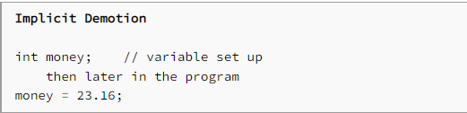
In this example the variable money is an integer. We are trying to move a floating-point value 23.16 into an integer storage location. This is demotion and the floating-point value usually gets truncated to 23.

Slide 13

This expression would evaluate to: 4.

Slide 14
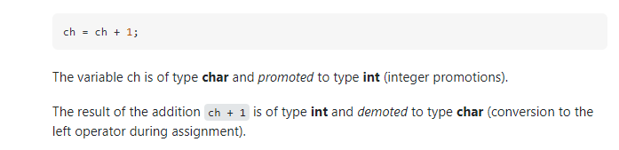

Slide 15
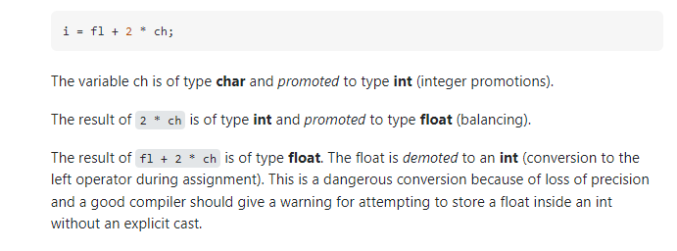

Slide 16
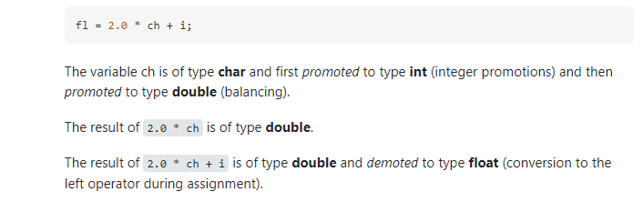

Slide 18
Explicit Type Casting
- Casting does not change the variable being cast.
For example, d is not changed after casting in the following code:
double d = 4.5;
int j = (int) d; //C-type casting
int i = static_cast<int>(d); // d is not changed cout<<j<<“ “<<d;

Slide 19
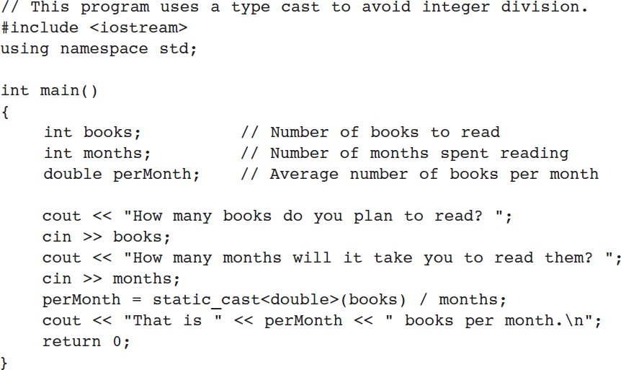
Explicit Type Casting - Example

Slide 20
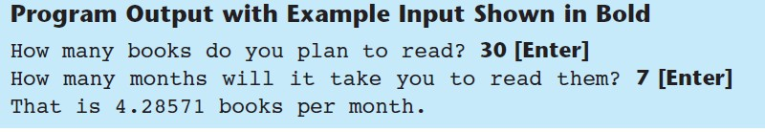
Explicit Type Casting - Example

Slide 21
C++ Selection Structures

Slide 22
Matching the “else”
#include <iostream>
using namespace std;
int main()
{
int a, b, c;
cout<<“Enter three numbers, a, b, and c:\n”;
cin >> a >> b >> c;
if( a==b )
if( b==c )
cout << “a, b, and c are the same\n”;
else
cout << “a and b are different\n”;
return 0;
}
if( a==b )
{
if( b==c )
cout << “a, b, and c are the same\n”;
}
else
cout<< “a and b are different\n”;
else
cout << “b and c are different\n”;

Slide 23
Switch – Example
int day;
cout<<“Enter day number“; cin>>day;
switch (day) {
case 1 :
case 7 : cout << "This is a weekend day";
break;
case 2 :
case 3 :
case 4 :
case 5 :
case 6 : cout << "This is a weekday"; break;
default : cout << "Not a legal day";
}

Slide 24
THANK YOU
QUESTIONS

Slide 25
Algebraic Expressions
Multiplication requires an operator
Area = lw is written as Area = l * w;
There is no exponentiation operator
Area = s² is written as Area = pow(s, 2); (note: pow requires the cmath header file) OR Area = s*s;
Parentheses may be needed to maintain order of operations
y2 − y1
m =
is written as: m = (y2-y1)/(x2-x1);
x2 − x1

Slide 26
Precedence Rules – Example 1
6 + 2 * 3 - 4 / 2
6 + 6 - 4 / 2
6 + 6 - 2
12 - 2
10

Slide 27
Precedence Rules – Example 2
3 * 4 / 2 + 3 - 1
12 / 2 + 3 - 1
6 + 3 - 1
9 - 1
8

Slide 28
Precedence Rules – Example 3
8 * 3 / 2 + 3 - 1
24 / 2 + 3 - 1
12 + 3 - 1
15 - 1
14
8 / 3 * 2 + 3 - 1
2 * 2 + 3 - 1
4 + 3 - 1
7 - 1
6

Slide 29
Precedence Rules (overriding)
For example: x = 3 * a - ++b % 3;
If we intend to have the statement evaluated differently from the way specified by the precedence rules, we need to specify it using parentheses ( )
Using parenthesis:
x = 3 * ((a - ++b)%3);

